Slide 1
Lecture 14: Conversion of DFA to RE(Iterative Method/ State Elimination Method)
Agenda:
Iterative Method of Conversion of RE to DFA
Algorithm
Example
Presented by
Prof. Vaibhav Narayan Chunekar
K. J. Somaiya College of Engineering, Vidyavihar, Mumbai

Slide 2
Iterative Method of Conversion of DFA to RE
GNFA is an NFA with transition being label by regular expression .
When to accept String by this GNFA?
Definition➔ GNFA is said to accept string w if w can be written as concatenation of w=w1.w2........wk, there exist state qo ,q1 q2,....qk GNFA such that
Q0➔ Start State Qk➔ accept state
For all i of Ri is label at transition qi-1 to qi then wi is the element of L(Ri).

Slide 3
Without Loss of generality we may assume the followings:
1.GNFA has unique accept state
2. There are no incoming transition to start state and no outgoing transition from the accept state.(Unique start state Qs )
3. There are transition from start state to every other state and from every state to the accept state . (Keep Phi on Transition)
4. There is transition between every pairs of state that are not start or accept state.

Slide 4
Algorithm
Convert DFA to a GNFA in the appropriate form. Start State and global accept state.
Remove each internal state (not start/accept state) with each iteration.

Slide 5
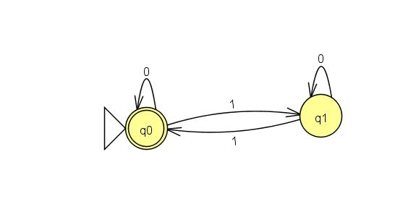
Example 1: DFA TO RE

Slide 6
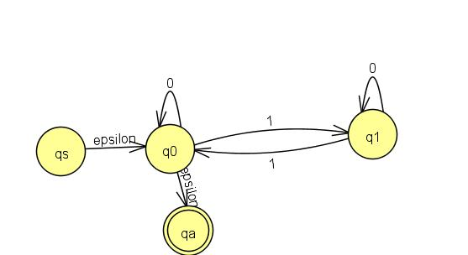
Removal of q1

Slide 7
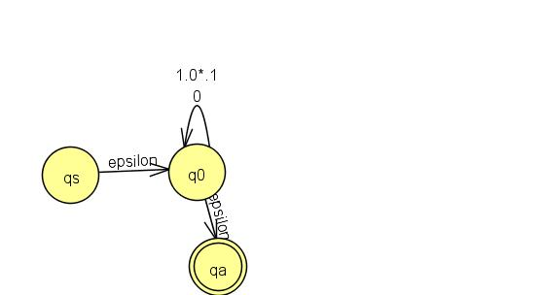
Removal of q0

Slide 8
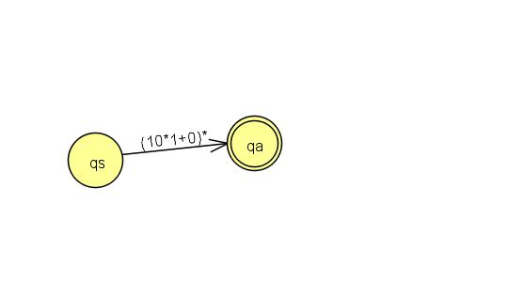
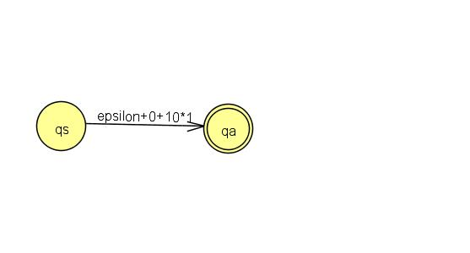
Final Regular Expession

Slide 9
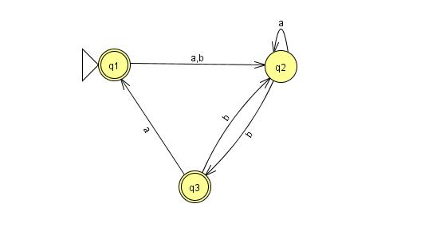
Example 2: DFA TO RE

Slide 10
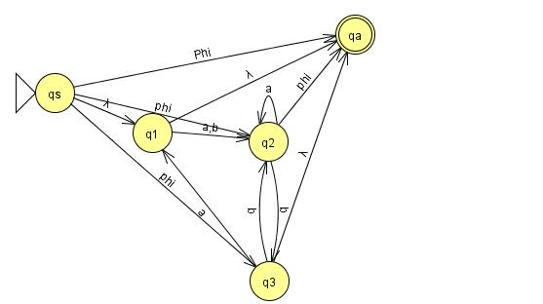
Create Start State and global accept state.

Slide 11
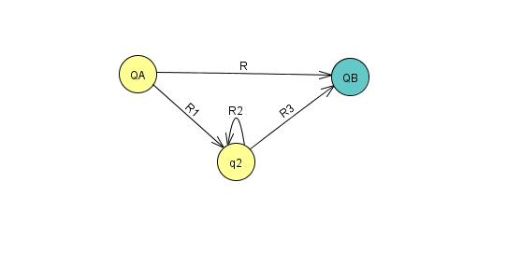
Example of How to Remove one internal state
➔ R + R1. R2*. R3

Slide 12
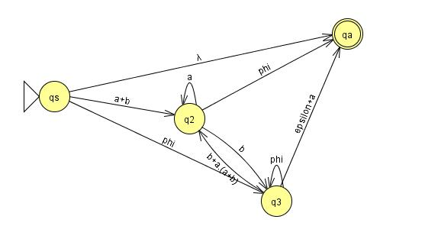
How to remove state q1

Slide 13
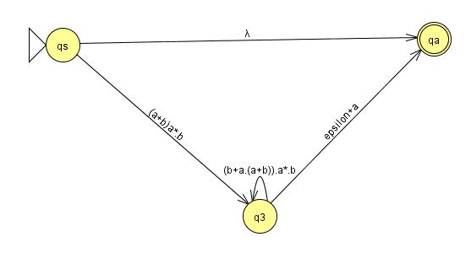
How to remove state q2

Slide 14
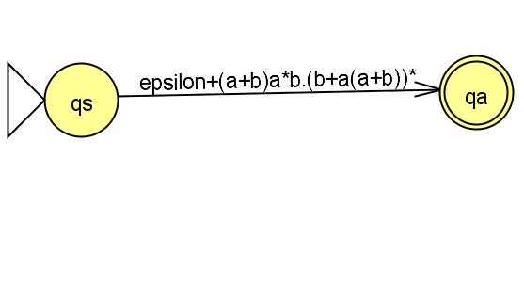
How to remove State q3

Slide 15
Thanks !!! Any ????

